Slide 1
CIS 240 Final Project
London House Price Analysis
Simeng Xiong

Slide 2
Introduction
Data Source: Kaggle - London Property Prices Dataset
Overview of Dataset:
The dataset contains 200k+ records, offering a detailed view of residential properties in London.
Includes historical prices, current sale and rental estimates, property characteristics, and geographic data.
Key Columns:
Full Address: Complete property address.
Latitude & Longitude: Geographic coordinates for mapping.
Property Details: Bathrooms, bedrooms, floor area, property type, and tenure.
Energy Rating: Represents the efficiency of each property.
Pricing Information: Historical sale prices, current sale estimates with confidence levels, and rental estimates.

Slide 3
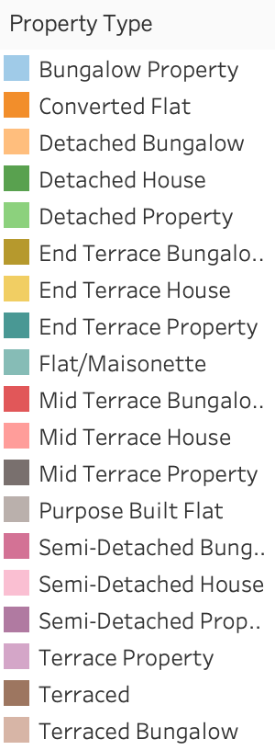
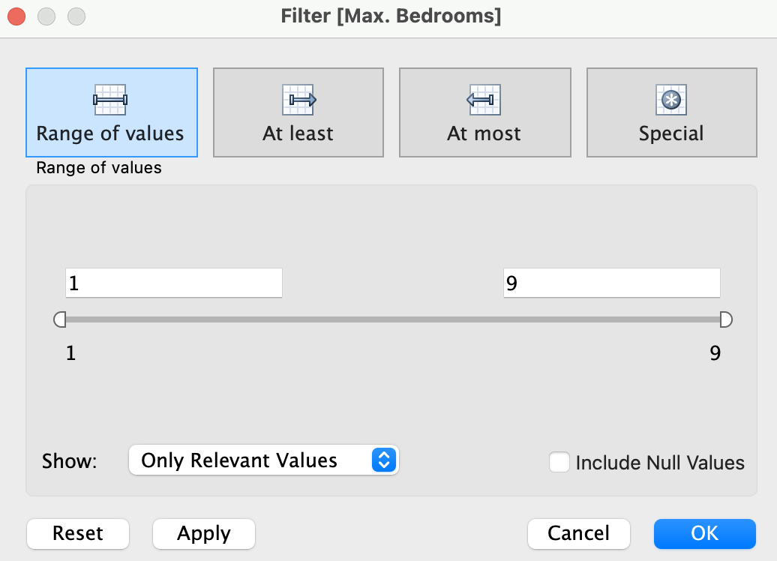
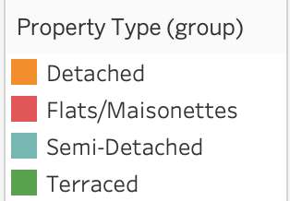
Data Cleaning and Transformation
Created a grouped field for Property Type to simplify analysis
Filtered out NAs in numbers of bedrooms, bathrooms, Property Type, Tenure
Notes:
Initially, we had a lot of specific property types, which made it difficult to extract meaningful insights at a higher level. To address this, we grouped these detailed property types into broader, more manageable categories, which you can see in the transformation shown here.
We grouped the properties into four main categories:
Detached: These are stand-alone homes that are not physically connected to other buildings, generally offering more privacy and space.
Flats/Maisonettes: These are units within a larger building, typically sharing walls, which makes them a more common choice for urban living.
Semi-Detached: Properties in this category are partially attached to another dwelling.
Terraced: These are properties in a row of similar units, each sharing walls with its neighbors.
By grouping these property types, we were able to simplify our analysis and focus on broader trends, making it easier to identify key insights without getting lost in excessive details.

Slide 4
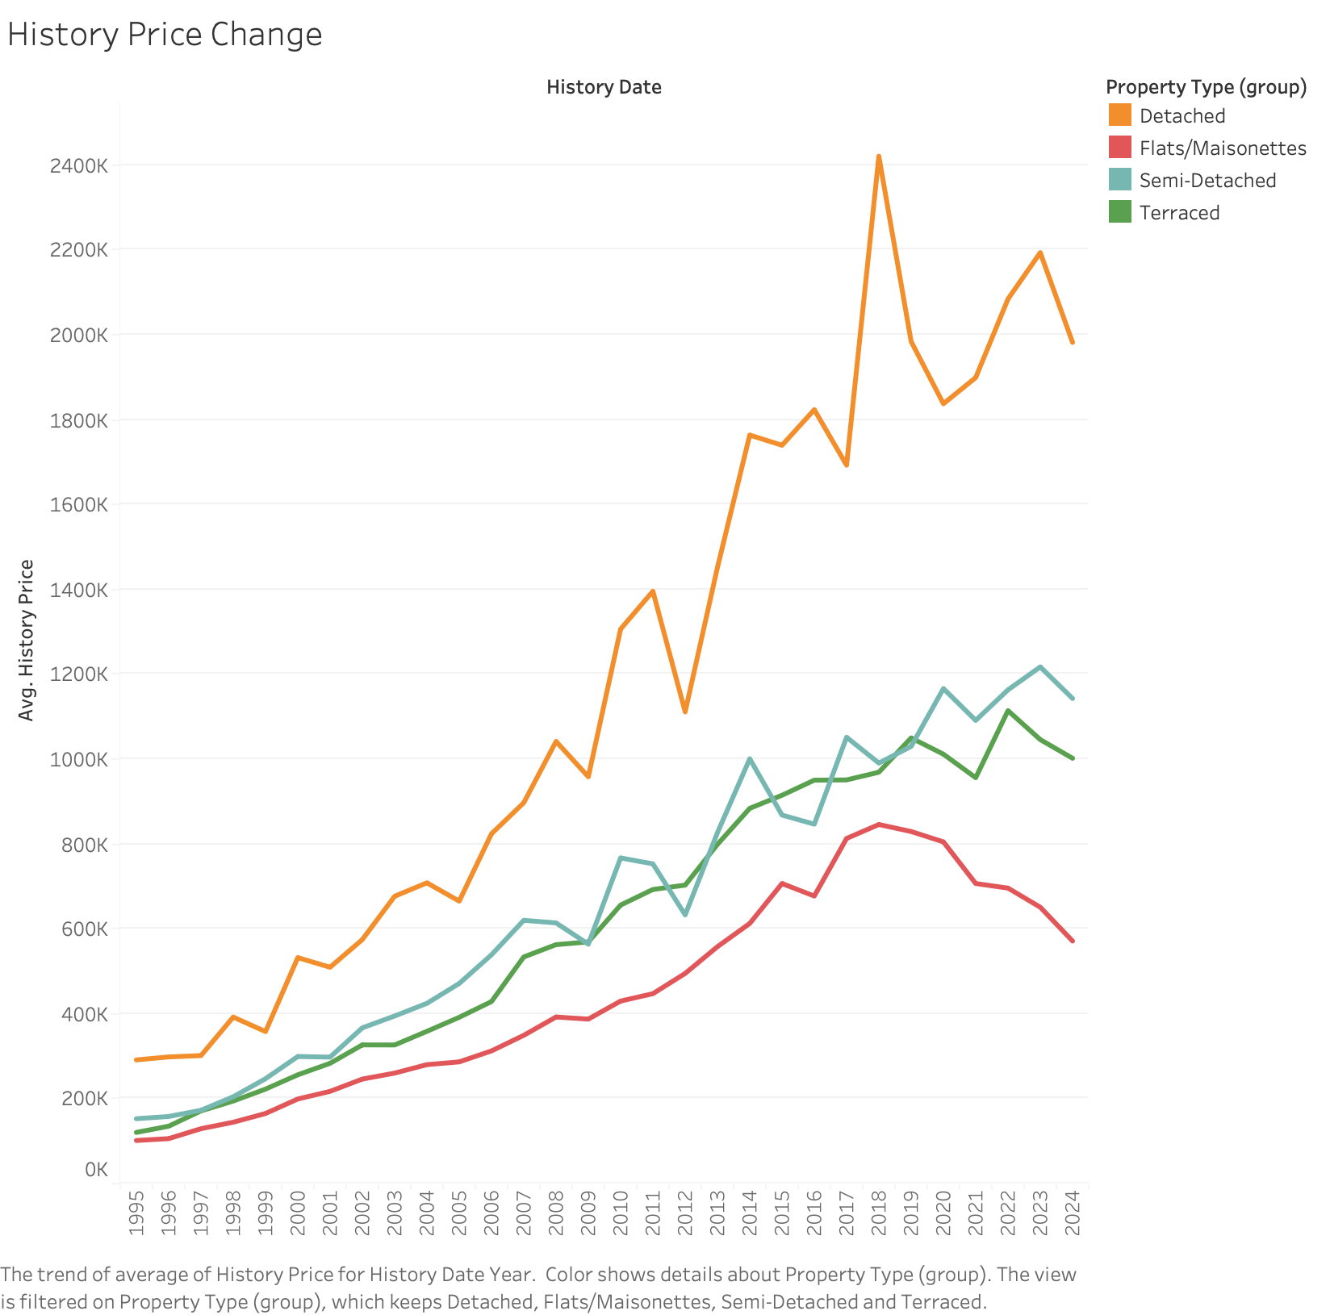
Visualization 1 - Historical Price Change Over Time
What is Visualized?: Line chart showing the average historical property prices over time for different type of property.
Question Being Asked: How have property prices changed over the years across different property types?
The visualization highlights consistent increases in average property prices over time, with Detached properties showing the steepest rise, especially around 2017-2018 and 2020-2023.
Flats/Maisonettes, Semi-Detached, and Terraced properties also show an upward trend but at a slower rate compared to Detached properties.
Flats/Maisonettes appear to have lost some of their value since 2018, maybe due to changing lifestyle needs, economic factors, or a supply-demand imbalance.
Notes:
Here, we have Visualization 1, which looks at the historical price changes over time for different types of properties in London.
This line chart shows the average historical property prices for Detached, Flats/Maisonettes, Semi-Detached, and Terraced properties from 1995 to 2024. The question we aim to answer here is: How have property prices changed over the years across these different property types?
As we can see, there has been a consistent increase in average property prices over time for all property types. However, the Detached properties stand out, with a particularly steep rise in price, especially between 2017-2018 and again around 2020-2023. This likely reflects their popularity and perhaps the growing demand for larger living spaces, particularly during the pandemic years.
Other property types, including Flats/Maisonettes, Semi-Detached, and Terraced properties, have also shown an upward trend, but at a slower pace compared to Detached properties.
One interesting observation here is that Flats/Maisonettes seem to have lost some of their appeal since 2018, as reflected by the decline in their average price. This could be due to changing lifestyle needs, such as preferences for larger homes, economic factors, or possibly a supply-demand imbalance.

Slide 5
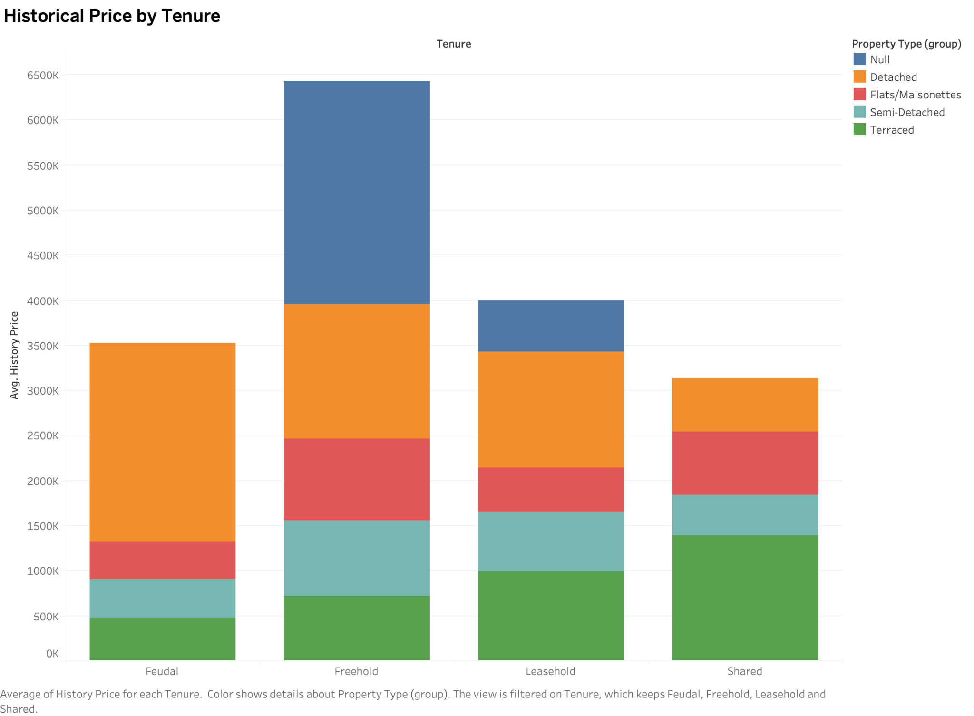
Visualization 2 - Historical Price by Tenure
What is Visualized?: Stacked bar chart showing the average historical property prices by different tenures, with details about property types within each tenure.
Question Being Asked: How do property prices vary by tenure type?
Freehold properties tend to be the most valuable, which could be due to their ownership structure that gives the buyer full ownership of both the property and the land.
The dominance of Detached properties in terms of average price indicates that they are typically the most valuable property type, contributing significantly to the overall value in each tenure.
Feudal and Shared tenures have lower average prices. This may be due to feudal properties having historical ties and restrictions, often including obligations or limited rights, while shared tenures involve co-ownership, which can make them less attractive.

Slide 6
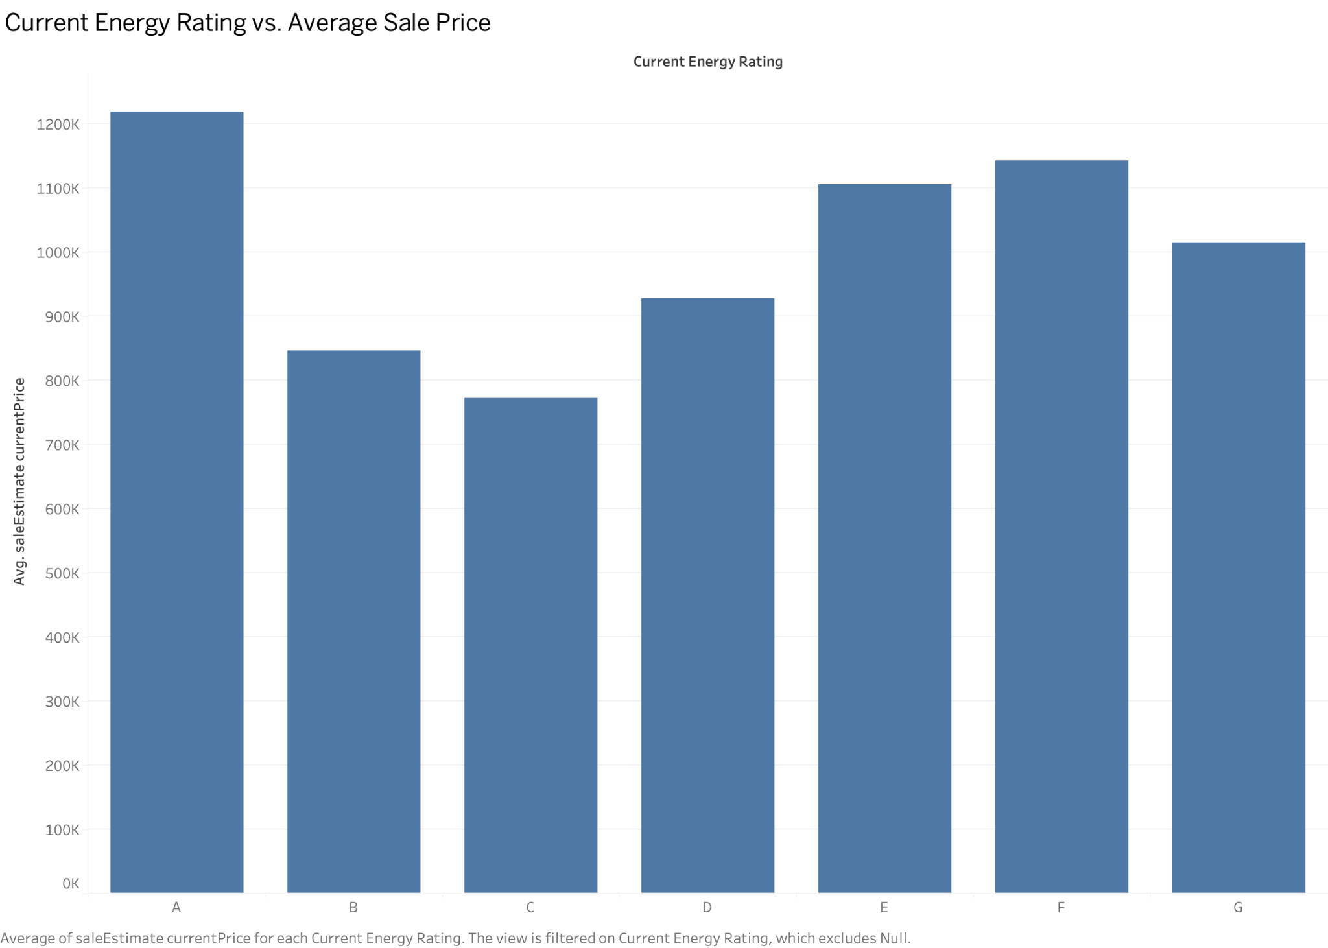
Visualization 3 - How Current Price affect by Energe Rate?
What is Visualized?: This bar chart shows the average sale price estimate for properties based on their energy rating (ranging from A to G) and excludes properties with Null energy ratings.
Question Being Asked: How do property current prices vary by current energy rating?
Energy-efficient properties (A) have a higher market value, suggesting an increasing buyer interest in sustainability and potential lower operational costs.
The lower average price of properties with ratings B and C could imply opportunities for upgrades that improve energy efficiency, potentially raising property values.
There is nothing indicated that an increase in energy efficiency lead to a increase in average current sale price.

Slide 7
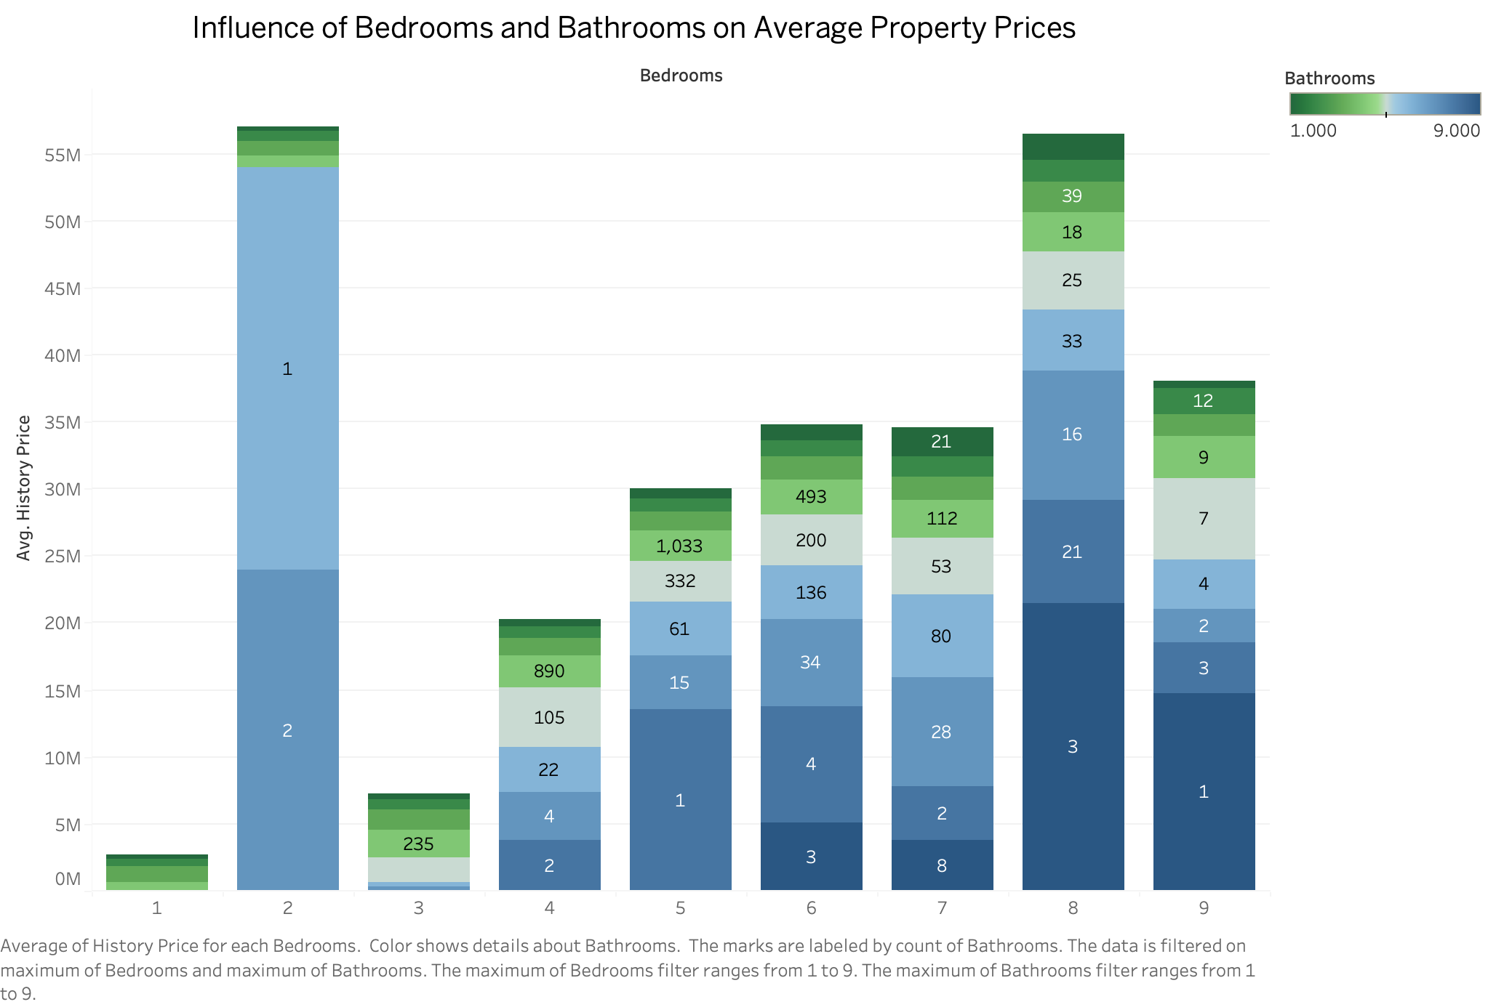
Visualization 4 - Influence of Bedrooms and Bathrooms on Historical Prices
What is Visualized?: This stacked bar chart shows the average property prices, stacked by the number of bathrooms, for each count of bedrooms. Each bar represents a different bedroom count, with segments in each bar indicating the varying number of bathrooms.
Question Being Asked: How do the number of bedrooms and bathrooms influence the average price of properties?
Impact of Bedrooms: Increasing the number of bedrooms generally leads to higher property prices.
Role of Bathrooms in Price Variation: Within each bedroom category, the number of bathrooms also affects prices. Properties with more bathrooms tend to be priced higher. This trend is consistent across different bedroom counts, indicating that bathrooms significantly add to property value. Properties with many bedrooms and several bathrooms show exceptionally high prices, suggesting that such properties are likely to be luxurious and spacious.

Slide 8
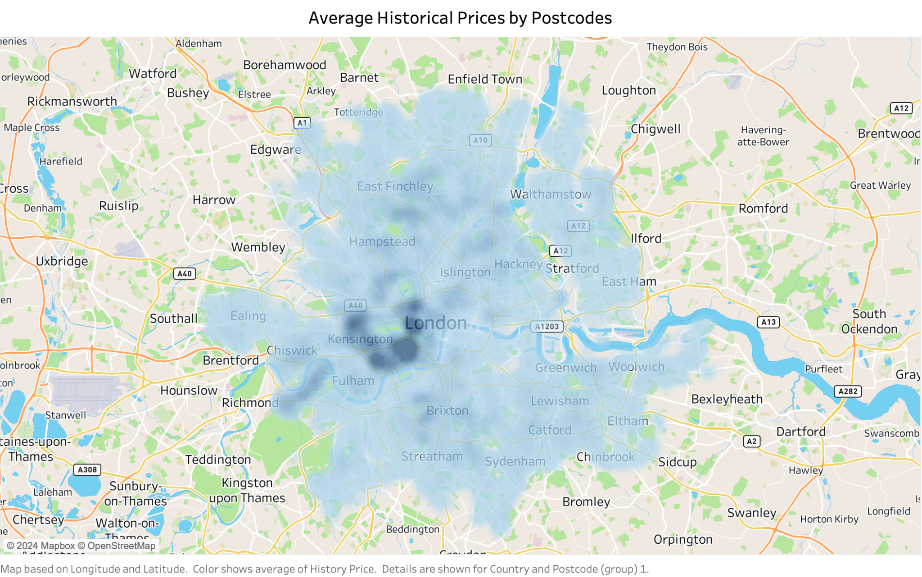
Visualization 5 - Average Historical Prices by Postcodes
What is Visualized?: The map provides a heatmap representation of average historic property prices in London. The data is aggregated by postcode areas and overlaid on a geographic map that includes key landmarks and transport routes for context.
Question Being Asked: How do average property prices vary across different areas of London?
Impact of Location on Value: The visualization underscores the impact of location on property values. Central areas like Kensington, Chelsea, and parts of Westminster show darker shades, indicating higher prices due to factors like proximity to central business districts, historical significance, and better amenities. This pattern provides insights into the desirability and economic status of different areas.

Slide 9
Next Step Idea
Investigate the impact of major social events
Study the Effects of COVID-19: Analyze how pandemics have altered buyer preferences and market trends, such as shifts towards more spacious properties outside city centers or increased demand for homes with office spaces.
Economic Recession Analysis: Examine property price trends before, during, and after major economic downturns to determine how different segments of the housing market respond to economic stress.
Analyze the Influence of Location on Property Prices
Proximity to Key Infrastructure: Quantitatively analyze how proximity to major transportation hubs (airports, train stations) and highways affects property values.
Access to Green Spaces: Study the correlation between the proximity to parks, rivers, and other green spaces and the increase in property prices, considering the growing demand for more natural surroundings within urban settings.
Historical Significance: Assess how being designated as a historical landmark or located in a heritage site impacts property values due to restrictions and desirability.

